Slide 1
SMART WATER FOUNTAINS

Slide 2
Abstract
In our fast paced world, the water fountain will be acting as the natural humidifiers and it also adds moisture to a dry room .
This is an overview of smart water fountain that jets the water into the aor in a decorative and dramatic effect.
Smart water fountain are commonly used to promote peace and well being. This smart water fountain uses an arduino which is an open source electronics platform.
The fountain works fully automatically but can also be set up remotely via a mobile app for your convenience.

Slide 3
Our smart water fountain will be used with a help of a laptop.
Flow of water from high gravitational potential energy to low gravitational potential energy causes a water fountain to form, due to increasing pressure on the inside of the symstem.

Slide 4
Materials needed
4x 12v mini fountain
4 relay module
Arduino
12v power supply for the mini fountain
Female/Male to jumper cables

Slide 5
Codes :
#define RELAY1 9
#define RELAY2 10
#define RELAY3 11
#define RELAY4 12
void setup()
{
OUTPUT
pinMode(Relay1,OUTPUT);
pinMode(Relay2,OUTPUT);
pinMode(Relay3,OUTPUT);
pinMode(Relay4,OUTPUT);
}

Slide 6
void loop()
{
digitalWrite(RELAY1,LOW);
delay(500);
digitalWrite(RELAY4,HIGH);
digitalWrite(RELAY2,LOW);
delay(500);
digitalWrite(RELAY1,HIGH);
digitalWrite(RELAY3,LOW);
delay(500);
digitalWrite(RELAY2,HIGH);
digitalWrite(RELAY4,LOW);
delay(500);
digitalWrite(RELAY3,HIGH);
}

Slide 7
The fountain works fully automatically but can also be set up remotely via a mobile app for your convenience.
Our smart water fountain will be used with a help of a laptop.
Flow of water from high gravitational potential energy to low gravitational potential energy causes a water fountain to form, due to increasing pressure on the inside of the symstem.

Slide 8
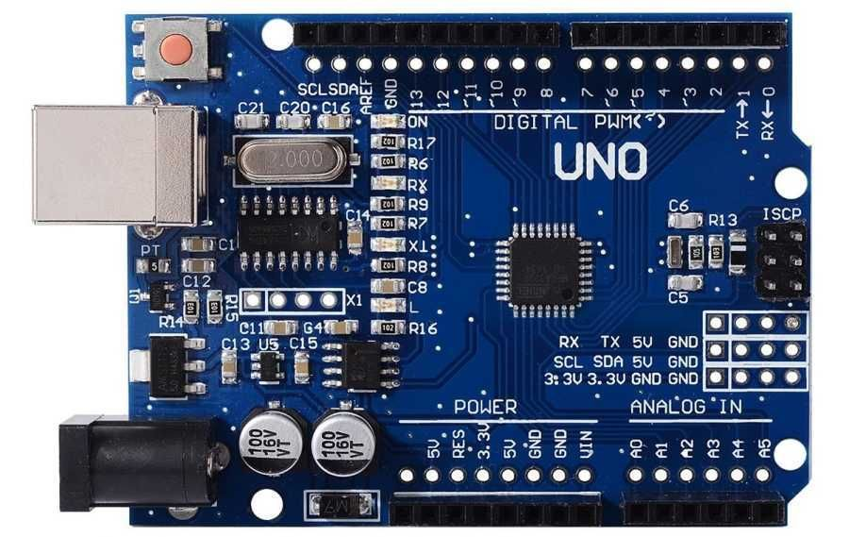
Arduino

Slide 9
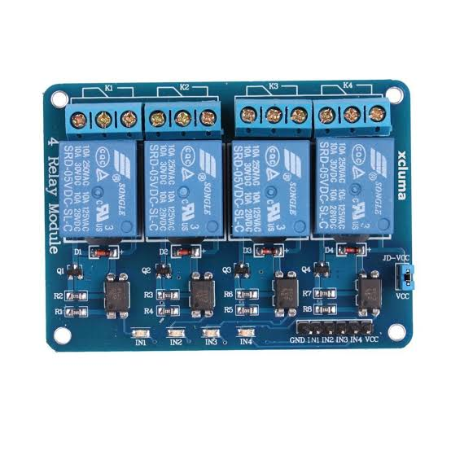
4 relay module

Slide 10
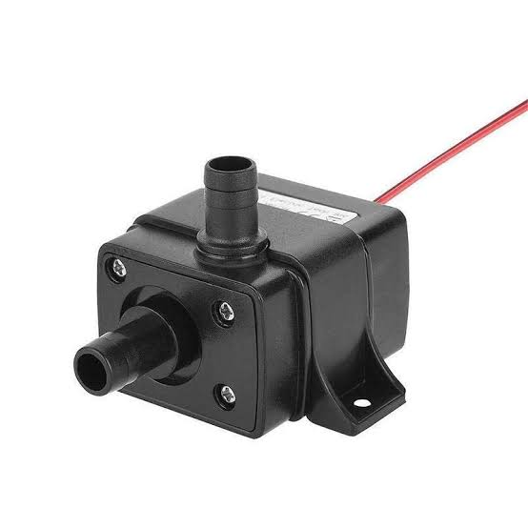
4x 12v mini fountain

Slide 11
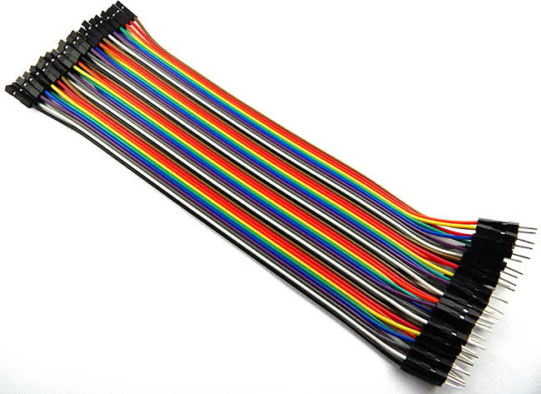
Female/Male to jumper cables

